Slide 1

BUPA Sustainable Supply Chain Summit 2025
Dr William Bird MRCGP MBE
GP Reading
Chair Active Essex
Hon Professor University Exeter CEO Intelligent Health
© 2023 Intelligent Health

Slide 2


Human and Planet sickness:
What’s the link?

Slide 3

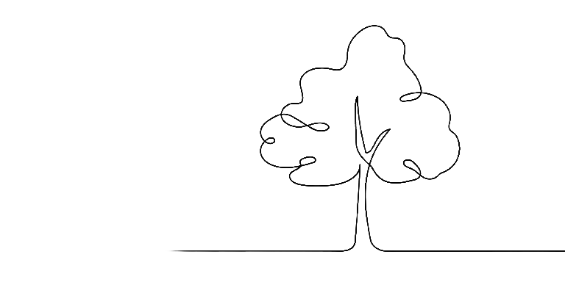
Ecosystem (Nature)
Ecosystem
(Human)
Gut, brain, skin Biome

Slide 4

Feeling Safe
Psychological safety is recognised as central to mental health, wellbeing (Sullivan et al, 2018) and post-traumatic growth (Norman et al, 2020)
Notes:
Feeling safe is the main function of the brain. It is the most fundamental instinct we have as an animal. These zebras will be relaxed and may play between feeding but alert for danger. When danger strikes they respond with adrenaline and cortisol. They then return to being relaxed and alert after the danger has passed.

Slide 5

Feeling Valued
Flett, G.L. and Heisel, M.J., 2021. Aging and feeling valued versus expendable during the COVID-19 pandemic and beyond: a review and commentary of why mattering is fundamental to the health and well-being. International Journal of Mental Health and Addiction, 19(6), pp.2443-2469.
Notes:
We will need to feel valued to be included. If we don’t have value we may drop in the pecking order or be outcast from the pack. As a child we need to feel valued and loved in order to be looked after by our mother.

Slide 6
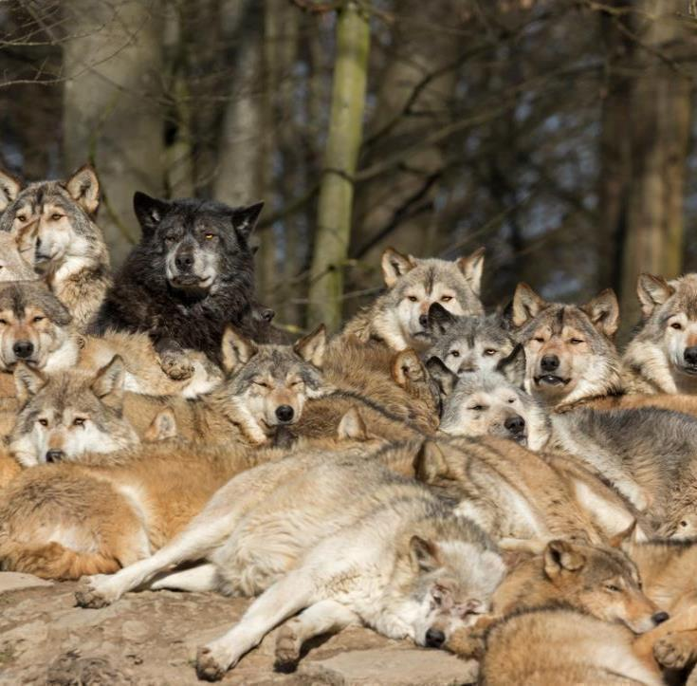
Sense of belonging
Trachtenberg, E., 2024. The beneficial effects of social support and prosocial behavior on immunity and health: A psychoneuroimmunology perspective. Brain, Behavior, & Immunity-Health, p.100758.
Notes:
We are pack animals and our mirror neurones mimic the feelings and actions of others. This creates a herd instinct and empathy and helps us collaborate a main success for our survival.

Slide 7
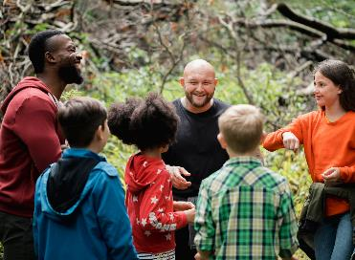
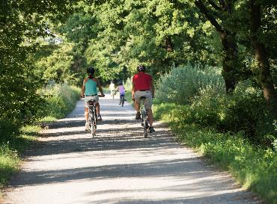
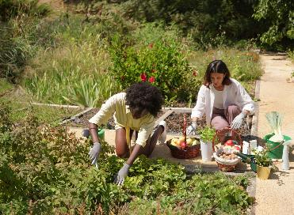


There are three domains that affect our sense of feeling safe, value and belonging.
People
Place
Purpose
2024 Intelligent Health

Slide 8









The Health Creation Matrix
People
Purpose
Place
Safe
Autonomy hope
Secure
Trust
Valued
Fulfillment
Resonance
Respect
Belong
Community
Values
Home

Slide 9


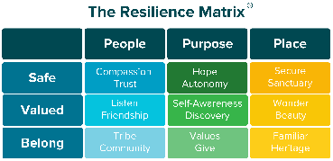

Stressors
Acute Stress
Hyperstasis
(Better State)
We Thrive

Slide 10
Autonomic Nervous System
Autonomic Nervous System
Parasympathetic
Sympathetic
Ventral Vagus
Dorsal Vagus
Fight, Flight
Freeze

Slide 11

Ventral Vagus Nerve
Social Engagement System

Slide 12

Stressors
Weak Resilience
Acute Stress
Chronic Stress,
Hyperstasis
(Better State)

Slide 13
Autonomic Nervous System
Autonomic Nervous System
Parasympathetic
Sympathetic
Ventral Vagus
Dorsal Vagus
Fight, Flight
(6) When we feel threatened the Sympathetic nervous system is activated. This is about fight and flight and switches off the ventral vagus nerve so we start to sacrifice long term health for short term survival
Freeze

Slide 14

Sympathetic Nervous System
Fight and Fight

Slide 15

Weak Resilience
Chronic Stress
Chronic Stress
Stress Hormones
Fear
Anxiety
Loneliness
Suspicion
Anger
Depression
Loss of inhibition
These are all normal emotions to keep us safe, valued or belong
Low or inappropriate high trust
© 2025 Intelligent Health

Slide 16




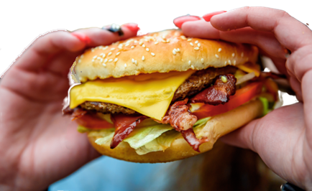
Weak Resilience
Chronic Stress
Stress Hormones
Negative Emotions
Poor Sleep
All these “unhealthy” lifestyles are protective when under stress
Inactivity
Unhealthy Behaviours
Poor diet
Poor Slee
Air Pollution
Obesity Gut Biome
Addictions
Disease
Diabetes, Dementia, Heart Disease
Depression, Arthritis, Anxiety,
Cancer, Stroke
Chronic Inflammation
Mitochondrial Dysfunction
2024 Intelligent Health

Slide 17
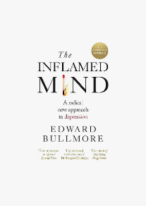
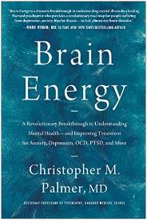
Weak Resilience
Chronic Stress
Stress Hormones
Negative Emotions
Unhealthy Behaviours
Environmental Toxins
Obesity Gut Biome
Disease
Diabetes, Dementia, Heart Disease
Depression, Arthritis, Anxiety,
Cancer, Stroke
Chronic Inflammation
Mitochondrial Dysfunction
2024 Intelligent Health

Slide 18



Chronic Stress
Picard, M., Kempes, C., Pontzer, H., Behnke, A. and Shaulson, E.D., 2025. Energy Constraints on Human Health.
Stress
Increased Chronic Stress uses up additional energy and takes it from Growth Maintenance and Repair. Cells become less efficient and demand more energy.
Chronic Inflammation uses up further energy
Growth Maintenance and Repair
Vital
© 2025 Intelligent Health

Slide 19
Weak Resilience
Chronic Stress
Stress Hormones
Negative Emotions
Furman, D., Campisi, J., Verdin, E., Carrera-Bastos, P., Targ, S., Franceschi, C., ... & Slavich, G. M. (2019). Chronic inflammation in the etiology of disease across the life span. Nature medicine, 25(12), 1822-1832.
Unhealthy Behaviours
Environmental toxins
Obesity Gut Biome
Disease
Diabetes, Dementia, Heart Disease
Depression, Arthritis, Anxiety,
Cancer, Stroke
Chronic Inflammation
Mitochondrial Dysfunction
2024 Intelligent Health

Slide 20
HCI adult factors
The statements that respondents are asked to rate
People
Purpose
Place
Most people are trustworthy |  | I feel in control of my life I’ve been feeling optimistic about my future |  | Overall, I think my neighbourhood is a good place to bring up children
The friendships and connections I have with other people mean a lot to me |  | I lead a fulfilling life |  | I enjoy exploring my neighbourhood
There is a group or community which I feel I belong to |  | I like sharing my time with others |  | I want to remain a resident of this neighbourhood for a number of years
Safe
Valued
Belong
Respondents are asked the extent to which they agree with each statement:
Strongly Disagree, Disagree, Neither Agree no Disagree, Agree, Strongly Agree

Slide 21
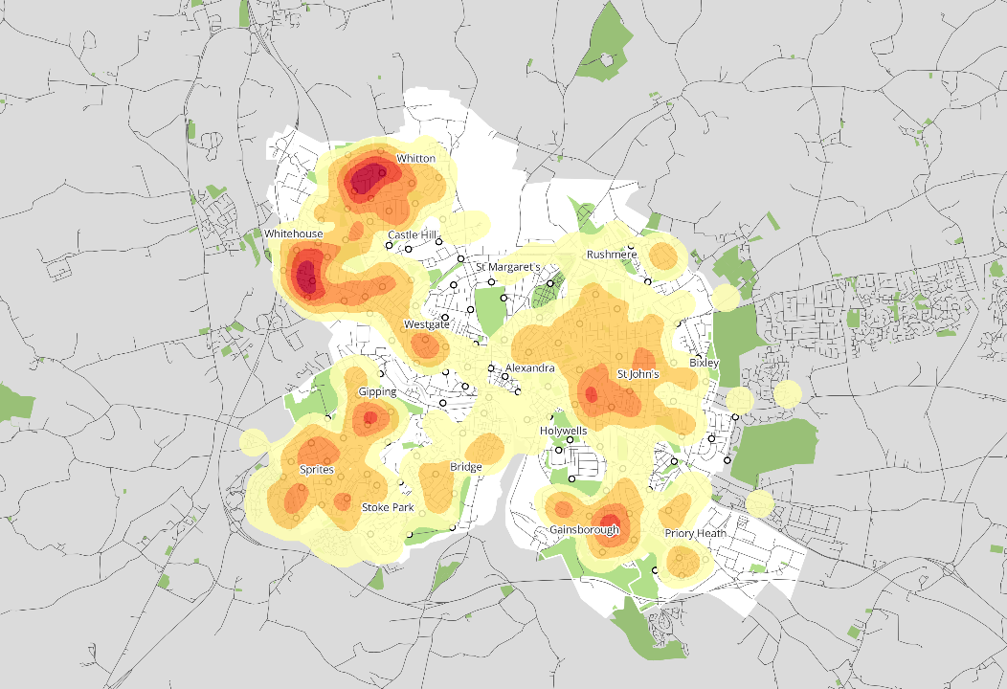
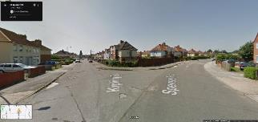
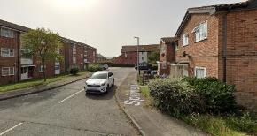


Ipswich - Granular Evidence supporting targeted effort
Ipswich Players Home Location: Low Health Creation, Physically Inactive, and Low Nature Connection
Key
Spencer Road
The insight can be used at street/neighbourhood level to understand the intersecting risk factors. Helping evidence need and build on strengths.
Beat Box Location
Higher density
Spinner Close
Lower density
334 players
OS data © Crown copyright and database right 2023
Notes:
Here in Ipswich we have combined the resilience score with inactivity and low nature connection. We are able to map this to street level helping to direct community development action to a granular level.

Slide 22

HCI
Diabetes
Aged 50+
The friendships and connections I have with other people mean a lot to me
I want to remain a resident of this neighbourhood for a number of years
I like sharing my time with others
I lead a fulfilling life
Overall, I think my neighbourhood is a good place to bring up children
I enjoy exploring my neighbourhood
HCI Index Score
I feel in control of my life
I've been feeling optimistic about my future
There is a group or community which I feel I belong to
Most people are trustworthy
Average Likert Score (1-5)

Slide 23
HCI
Intersectionality
The friendships and connections I have with other people mean a lot to me
I want to remain a resident of this neighbourhood for a number of years
I like sharing my time with others
I lead a fulfilling life
Overall, I think my neighbourhood is a good place to bring up children
I enjoy exploring my neighbourhood
HCI Index Score
I feel in control of my life
I've been feeling optimistic about my future
There is a group or community which I feel I belong to
Most people are trustworthy
There is a wide gap for the intersectionality group.
The group represents people who are all of these;
Female
Long-term limiting Health condition or Disability
Living in the most deprived quintile.
The gap is even greater for good place to bring up children
Responses (n):
Average 22,349
Intersection 288
Average Likert Score (1-5)
#Walk21Tirana
#Time4Walking

Slide 24
HCI
Mental Health
The friendships and connections I have with other people mean a lot to me
I want to remain a resident of this neighbourhood for a number of years
I like sharing my time with others
I lead a fulfilling life
Overall, I think my neighbourhood is a good place to bring up children
I enjoy exploring my neighbourhood
HCI Index Score
I feel in control of my life
I've been feeling optimistic about my future
There is a group or community which I feel I belong to
Most people are trustworthy
Average Likert Score (1-5)

Slide 25
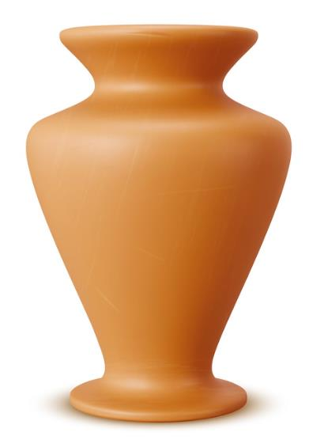
Health Creation
Safe, Value, Belong
Poor Health Creation leads to Chronic Stress
Lifestyle Prevention
Sleep, Physical Activity, Diet Smoking Alcohol
Medical Prevention
Obesity, Hypertension, Gut Biome
Chronic Stress leads to Chronic Inflammation
Treatment
Diabetes, Depression, Dementia, Heart disease, Inflammatory Bowel Disease, COPD, Anxiety.
Chronic Inflammation leads to these Diseases
© 2025 Intelligent Health

Slide 26

As our Planet Heats our environment is becoming less safe

Slide 27
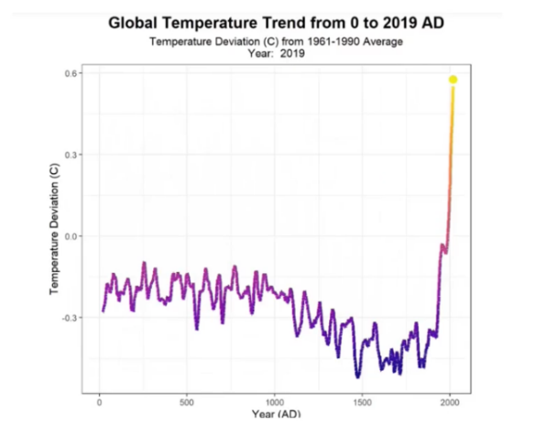
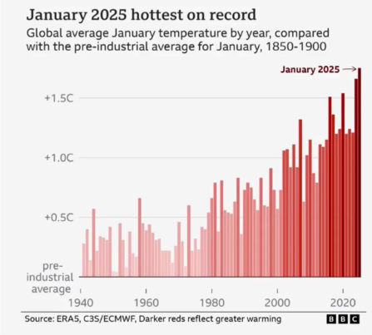
2024 was hottest since125,000 years ago

Slide 28
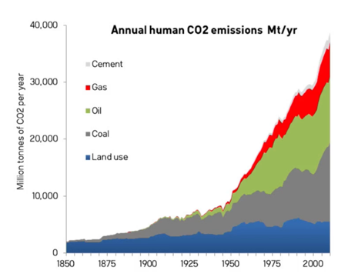
CO2 emissions continue to climb

Slide 29
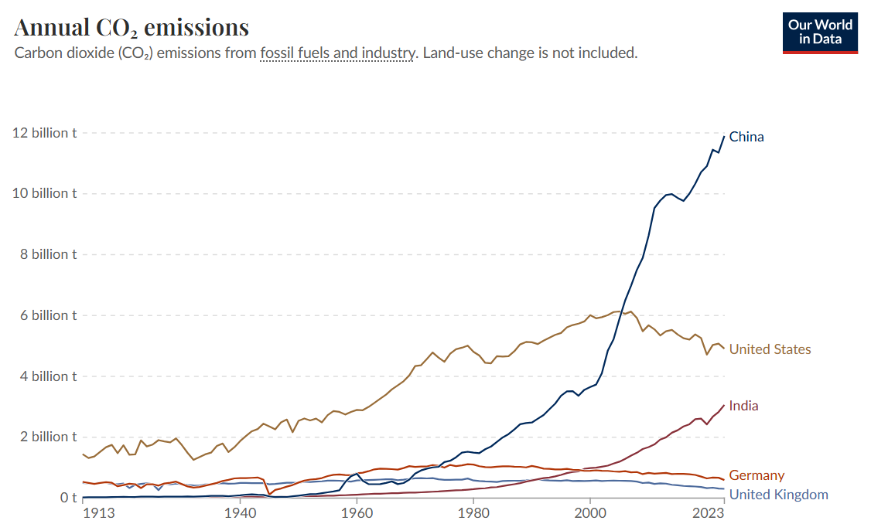

Slide 30
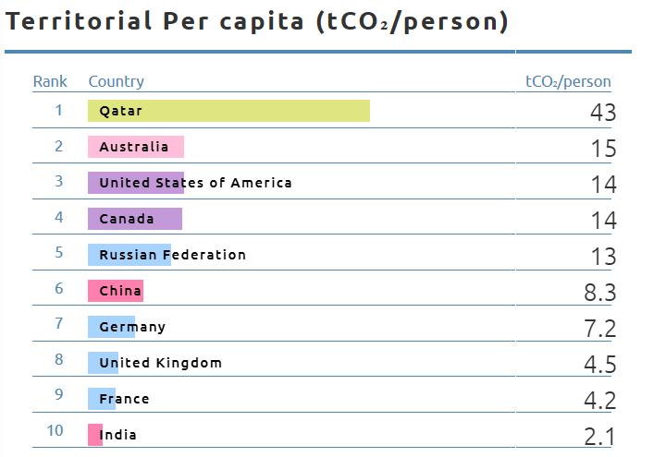
CO2 per Capita

Slide 31
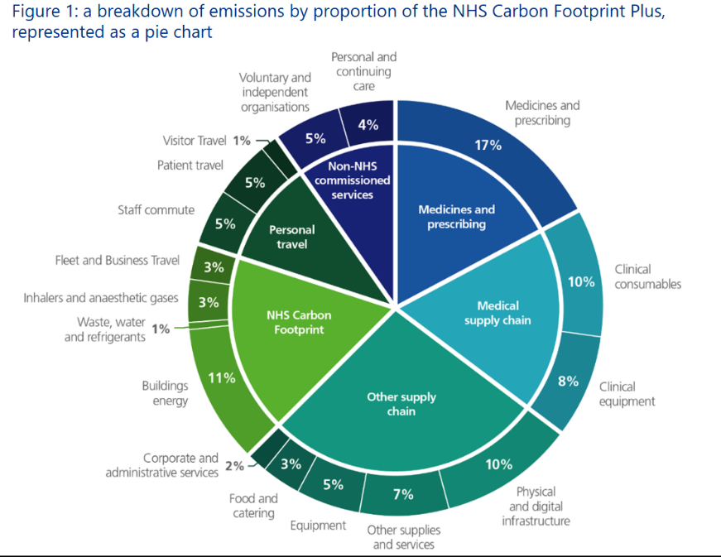

Slide 32

Disconnect from Nature

Slide 33
Association Between Trees, Vegetation, Depression and Stress
Normalized Difference Vegetation Index (NDVI)
Mitchell, R. and Popham, F. (2008) Effect of exposure to natural environment on health inequalities:
an observational population study. The Lancet 372(9650):pp. 1655-1660.

Slide 34
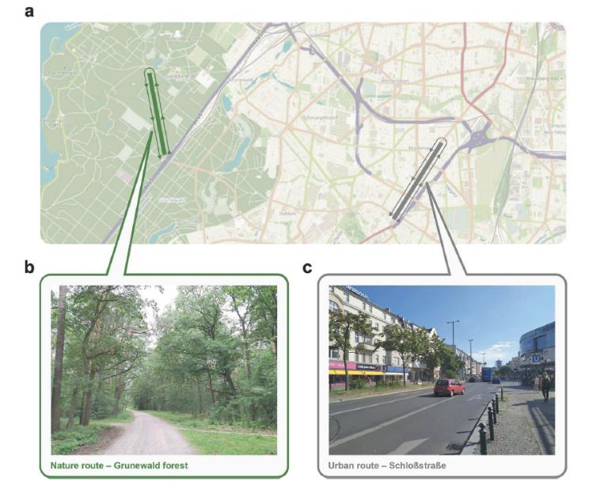
How a short walk in Nature can change your brain structure

Slide 35
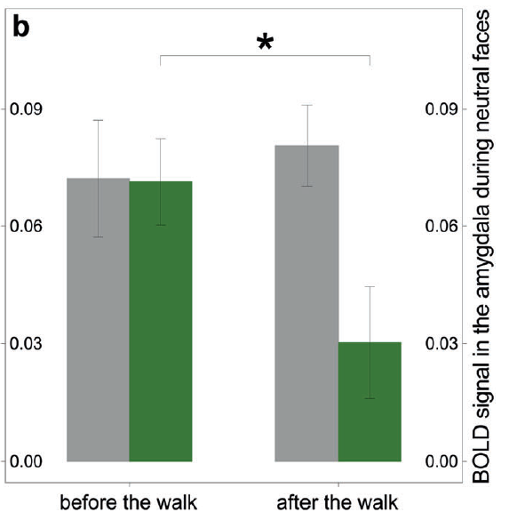

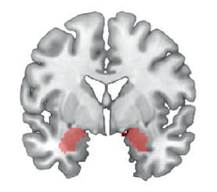
Amygdala changes after 60 min walk
Sudimac, S., Sale, V. and Kühn, S., 2022. How nature nurtures: Amygdala activity decreases as the result of a one-hour walk in nature. Molecular psychiatry, 27(11), pp.4446-4452.

Slide 36
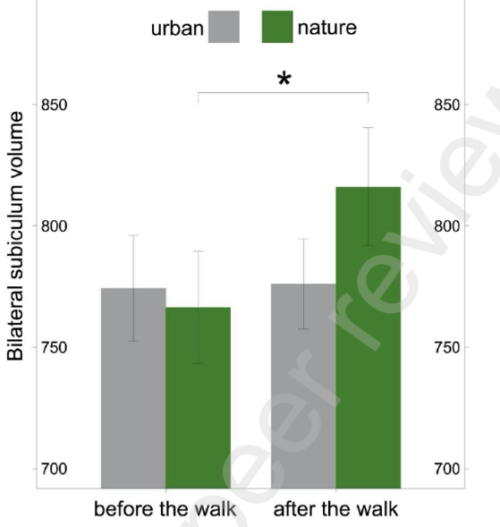
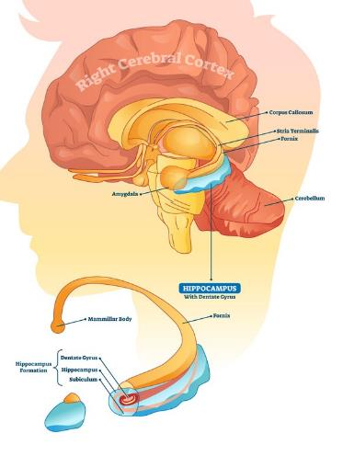
Hippocampus changes after 60 min walk

Slide 37
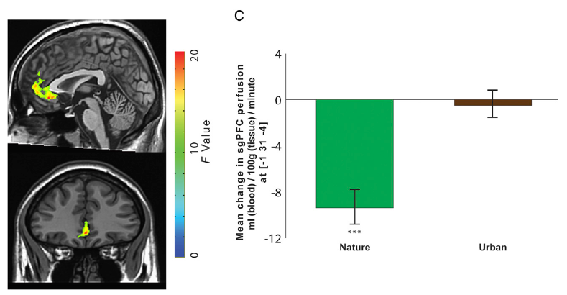
Reduced blood flow in the prefrontal cortex reduces negative rumination
Bratman et al. 2015. Nature experience reduces rumination and subgenual prefrontal cortex activation. PNAS. 112(28):8567-8572

Slide 38
Start Well
High
Blood Pressure
in pregnant
women increased
by 14% for every
300 meters away
from green
space
Birth
weight was
healthier
within the 500
metres of
green space
1. Grazuleviciene R et al Int J Environ Res Public Health 2014 11 2958-2972
2. Dadvand P Env Health Perspectives 120 10

Slide 39
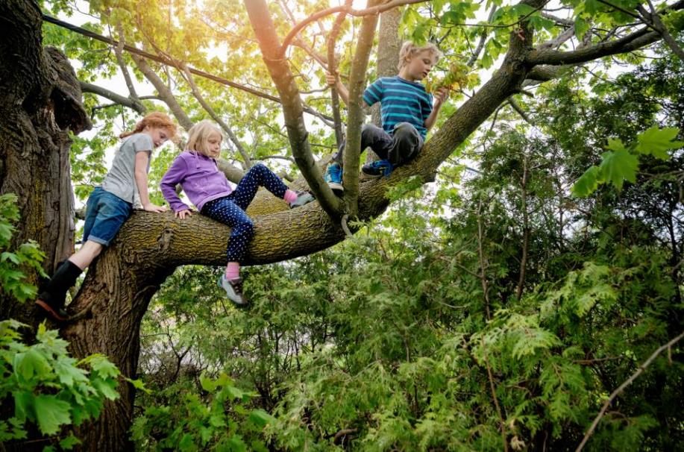
Grow Well
Rural children have a larger Hippocampus compared to urban children
Kühn, et al 2020. Brain structure and habitat: Do the brains of our children tell us where they have been brought up?. NeuroImage, 222, p.117225.

Slide 40

Children aged 5-7yrs: Longer time spent in public green spaces was associated with longer telomeres
Grow Well
Miri, M., de Prado-Bert, P., Alahabadi, A., Najafi, M.L., Rad, A., Moslem, A., Aval, H.E., Ehrampoush, M.H., Bustamante, M., Sakhvidi, M.J.Z. and Nawrot, T., 2020. Association of greenspace exposure with telomere length in preschool children. Environmental Pollution, p.115228.

Slide 41





Mitochondrial dysfunction shortens the telomeres
Venturelli, M., Morgan, G.R., Donato, A.J., Reese, V., Bottura, R., Tarperi, C., Milanese, C., Schena, F., Reggiani, C., Naro, F. and Cawthon, R.M., 2014. Cellular aging of skeletal muscle: telomeric and free radical evidence that physical inactivity is responsible and not age. Clinical science, 127(6), pp.415-421.
Notes:
24 mins
Some of the Free Radicals that leak out from the mitochondria when we are sedentary move into the nucleus and attack the chromosomes. This is serious! They target the end of the chromosome called the Telomere. The telomere is like the plastic bit at the end of a shoe lace. It stops the chromosome from unravelling. It also shortens every time a cell divides. Cells divide to replace an old cell. When the cells stop dividing they are not replaced and that is called aging! Our skin gets thinner, muscles weaker, brain smaller and bones weaker! This actually starts from the age of 28yrs old!
If the telomere is long then the aging process will be delayed. If it is short then the cell has fewer divisions left. Once the telomere runs out of runway (so to speak) then the cell no longer can divide and it goes into senescence (see next slide) which is when it is neither dead or alive (Zombie like). This state attracts a large inflammatory response as the body attacks it and destroys the cell. This contributes to Chronic Inflammation. Senescence cells are part of the aging process.
So the more free radicals released the shorter the Telomeres the faster the aging and the greater the inflammation.
There is more! There is an enzyme called Telemorase that can repair and actually lengthen the Telomere. It could almost be called the elixir of life. Guess what releases Temelorase? Yes it is physical activity. Being active releases Temelorase and can actually delay or even halt the aging process by lengthening Telomeres.

Slide 42

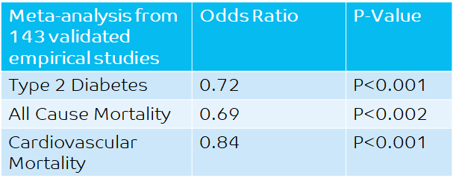
Health Benefits of Nature
Stay Well
Twohig-Bennett, C. and Jones, A., 2018. The health benefits of the great outdoors: A systematic review and meta-analysis of greenspace exposure and health outcomes. Environmental research, 166, pp.628-637.
Notes:
31 mins
Connecting to Nature has additional benefits due to three factors.
Reduces stress (the main reason)
Increases sociability in green space
Greater levels of physical activity

Slide 43
Nature
Weak Resilience
Nature
Chronic Stress
Stress Hormones
Nature
Negative Emotions
Nature
Unhealthy Behaviours
Nature
Nature
Air Pollution
Obesity Gut Biome
Disease
Diabetes, Dementia, Heart Disease
Depression, Arthritis, Anxiety,
Cancer, Stroke
Chronic Inflammation
Mitochondrial Dysfunction
Nature
Nature
2024 Intelligent Health

Slide 44
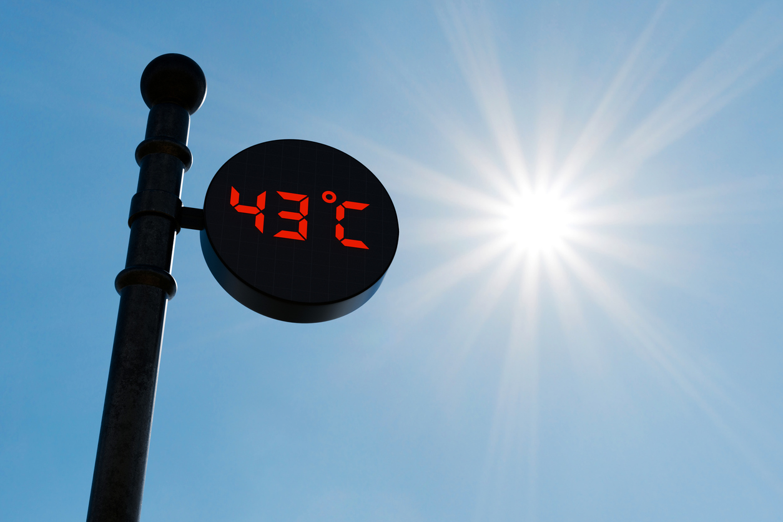
Heat
Hot weather is associated with increased deaths mainly from heart disease within 24 hours.
Extreme heat is doubling every 10 years since 1979
Every 0.1C of global temperature exposes a further 100 million people to extreme heat.
By the end of the century no major city will safely be able to hold a summer Olympic Games due to extreme heat.

Slide 45
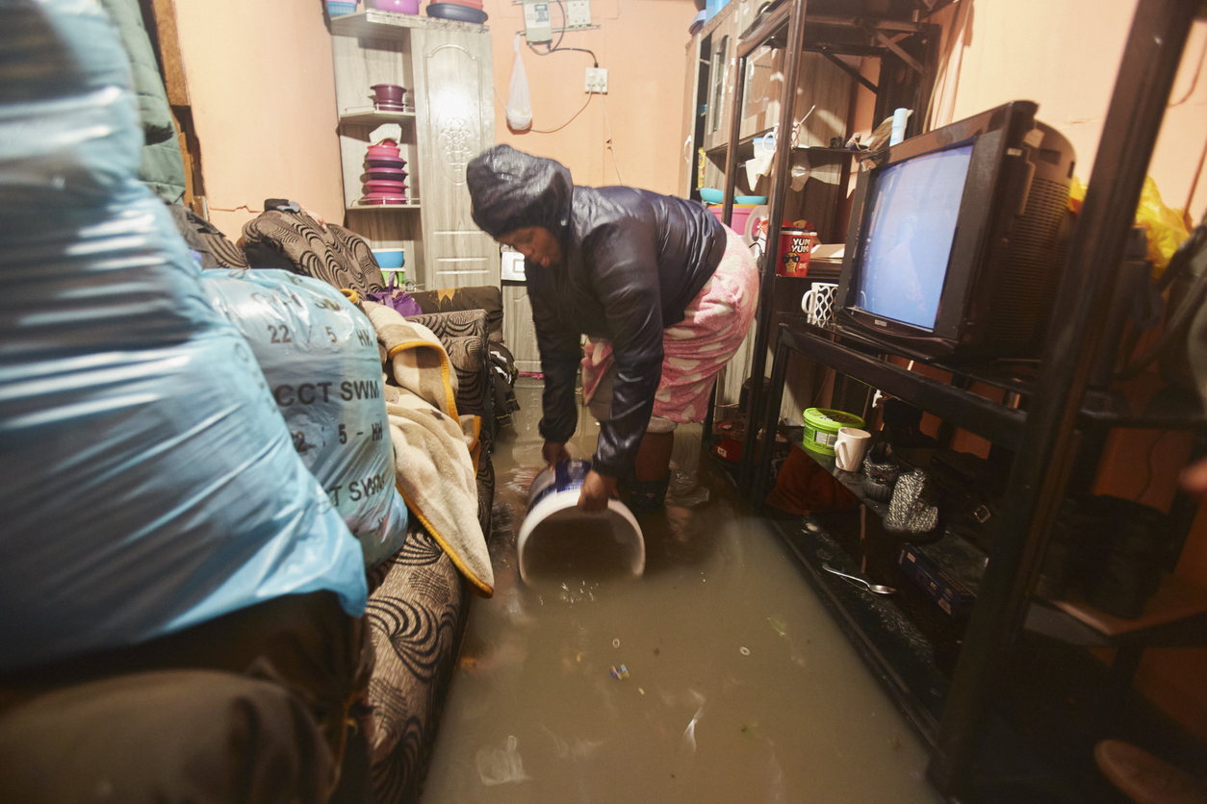
Floods
The Environment Agency update finds that 8 million (“one in four properties”) could be liable to flooding by mid-century when accounting for climate change.
Globally, flood hazard could ~increase by up to 50 % if we don’t restrain emissions.
Depression outcomes were elevated by 8-fold and PTSD by 14-fold among flooded compared with unaffected participants

Slide 46
For every rise in night-time temperature of 10C there is 20% less sleep across a population.
Sleep

Slide 47
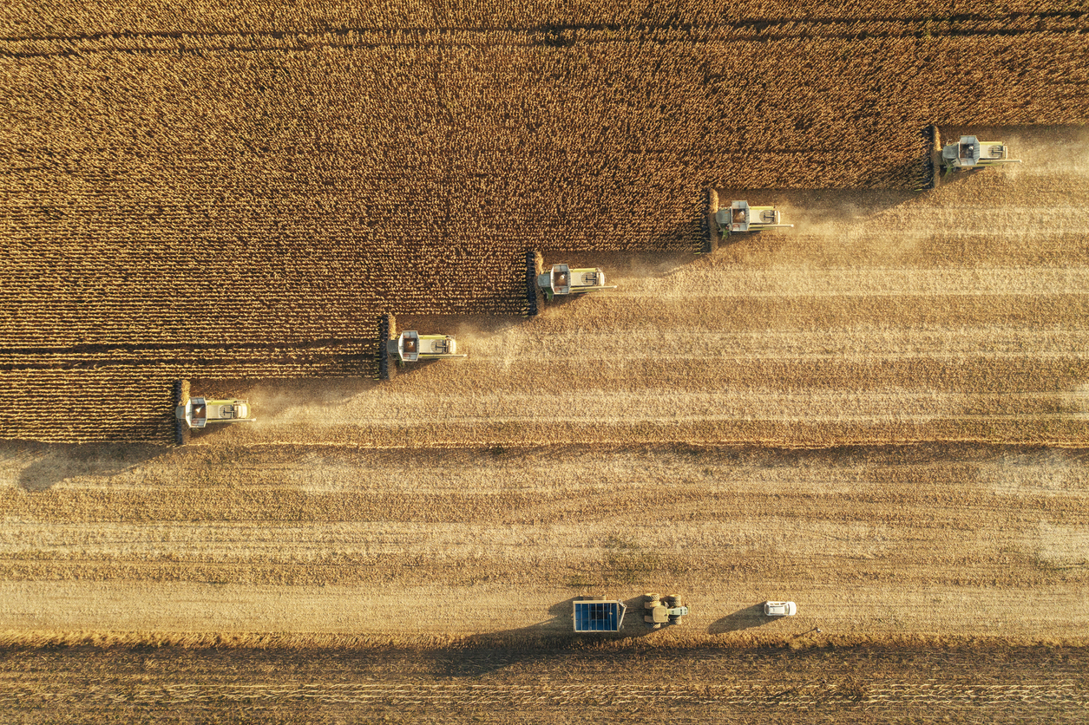
Food supply
Food crisis is already here.
More heat requires more intense farming
This requires more water and more energy
Food inflation has already started
700 million people face hunger 9% of the population
That’s 150 million people more than in 2019

Slide 48

Food supply
Brazil produces 10% of global food and 50% of all Soya Bean and 30% of all Beef.
18% of the Amazon is already deforested if this reaches 20-25% and the global temperature exceeds 2C then we could reach a tipping point and the hotter drier climate may make food production impossible.

Slide 49

Oceans and Food Supply
90% of the excess heat trapped in the atmosphere has been absorbed by the earth’s oceans
Sea temperatures have been rising by a steady 0.42C per decade.
In March 2023 they rocketed by 0.28C in just 5 months.
Resulting in mass coral bleaching in 62 countries
Less mixing of layers of water so less Phytoplankton that produce 50% of the planet’s Oxygen.
Even if CO2 stopped today 10% of Oxygen in oceans would be lost
Less phytoplankton also means less food for fish and so less food for us.

Slide 50
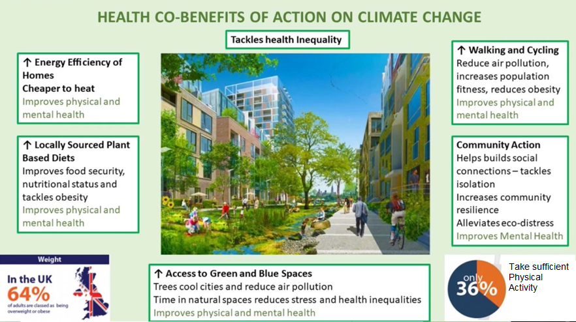

Slide 51
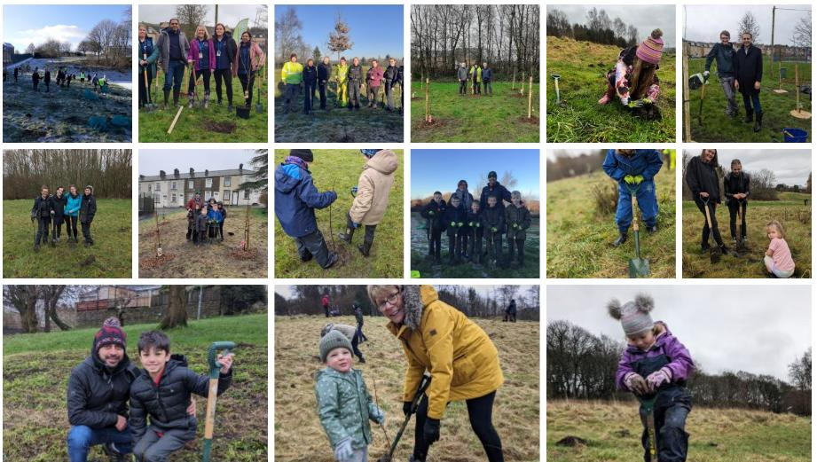
Over 2,500 trees were earned through playing Beat the Street in Burnley (2000 points = 1 tree)
(52) Beat the Street helped facilitate the creation of the Outdoor Town (Burnley) Using points as a currency 2,500 trees were purchased and planted by the families in Burnley
Schools and community groups were invited back to help plant them across the borough.
The combination of tree planting and active community engagement helps foster a sense of pride of Place

Slide 52

Building Active Communities
William.bird@intelligenthealth.co.uk

